Slide 1
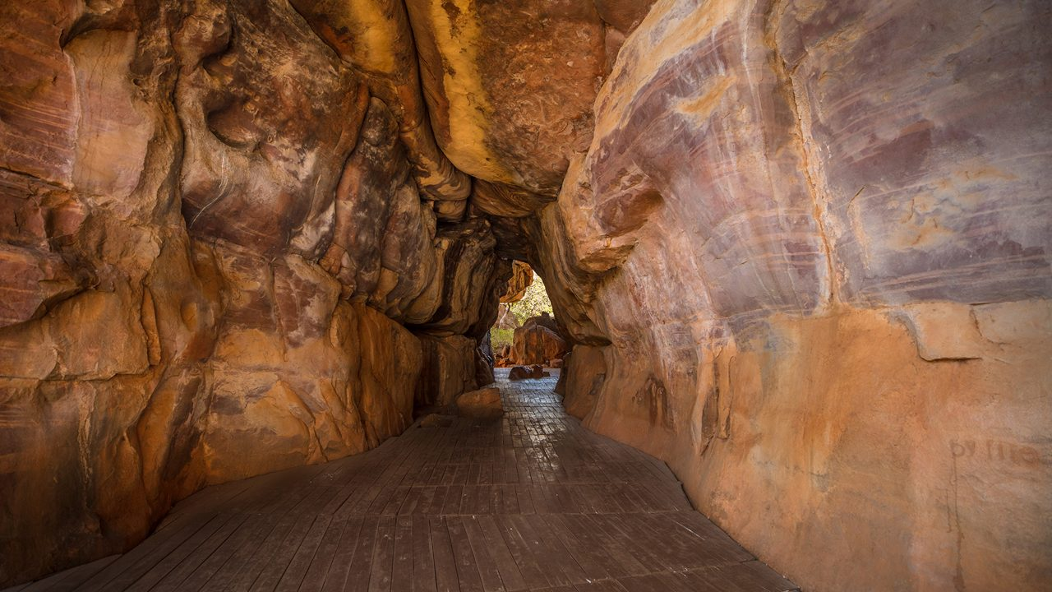
DEPARTMENT OF HISTORY
BHARATI COLLEGE
The founding of Bharati College in 1971 marked the beginning of teaching of history as a part of the BA (P) course. However, the Department of History as a distinct entity made its beginning in 1990, when BA (Hons.) was introduced.

Slide 2
VISION OF THE DEPARTMENT
The Vision of the Department is to inculcate in our students an original and informed approach to historical change, as well as to introduce them to the complexities of the Historian’s craft. Students are exposed to the primary sources/archive, but also taught about the politics behind the production of the archive. By thus, contextualizing their historical engagement with political, social, cultural, and economic processes, the Department equips its students with a basic but deep understanding of the contemporary world- a particularly valuable asset when they enter the workforce. In consonance with the vision statement of the College, the Department is dedicated to advancing the cause of women’s education.
After completing their graduation, the students will:
Have a solid grasp of the course of Indian history from prehistoric to contemporary times
Be aware of the significant developments of world history
Possess developed skills such as effective writing and critical analysis
Our courses prepare our students to pursue a wide range of careers in the legal field, education, civil services, archives, and museum, management, heritage and tourism, archaeology, judiciary, social art and social psychology and journalism etc. The department of history adopts the universal design to learning so as to create classroom that are responsive to the needs of multi-lingual, multi-level, and multi-cultural students. This inclusive approaches enables learners from diverse background to engage more meaningfully with historical studies.

Slide 3
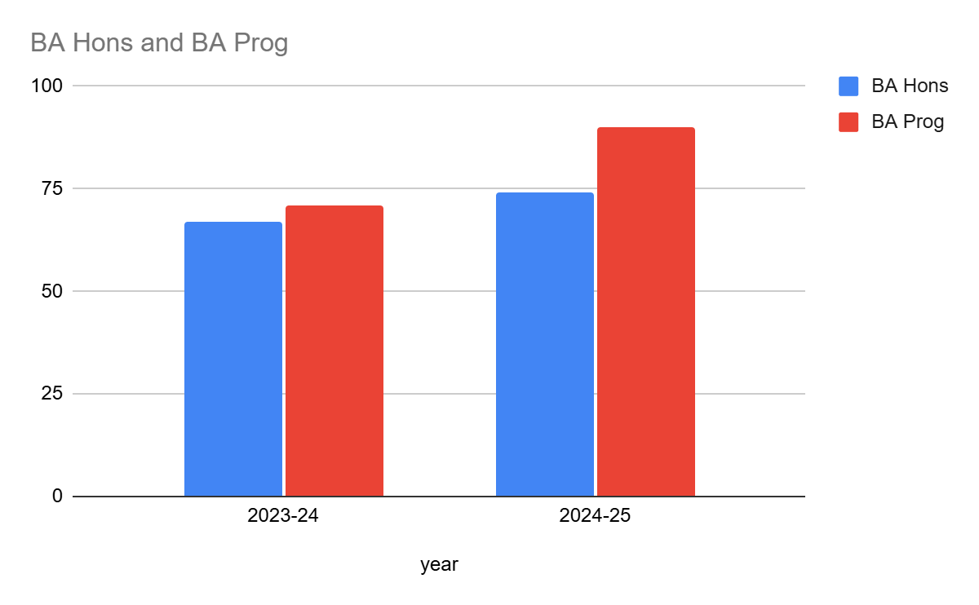
B.A. Hons. And B.A. Prog. Popularity of the History discipline is reflected in the given graph

Slide 4
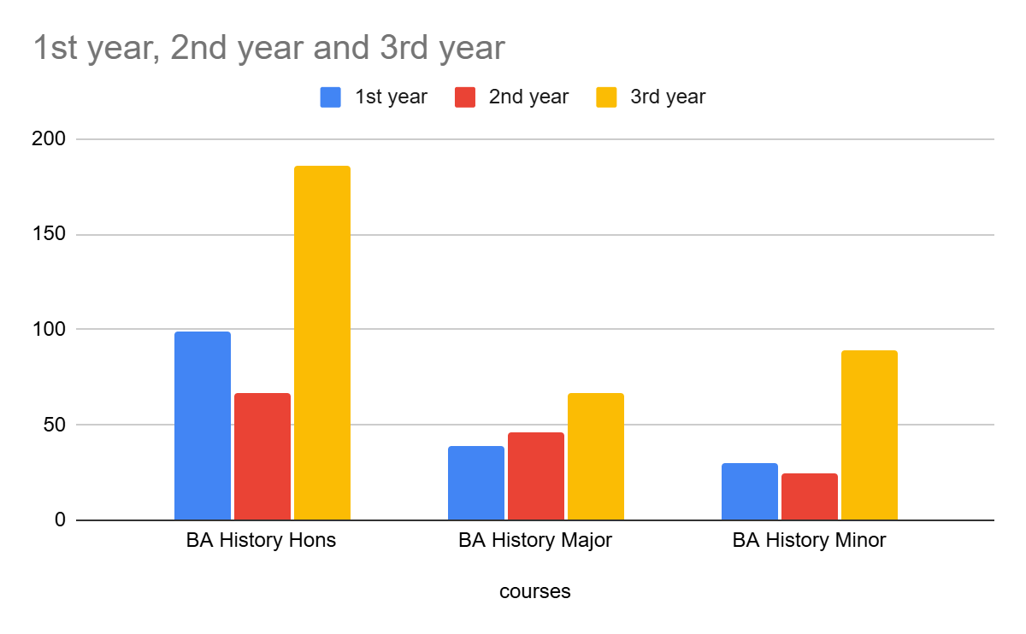
Students in Different Courses (2023-24)

Slide 5
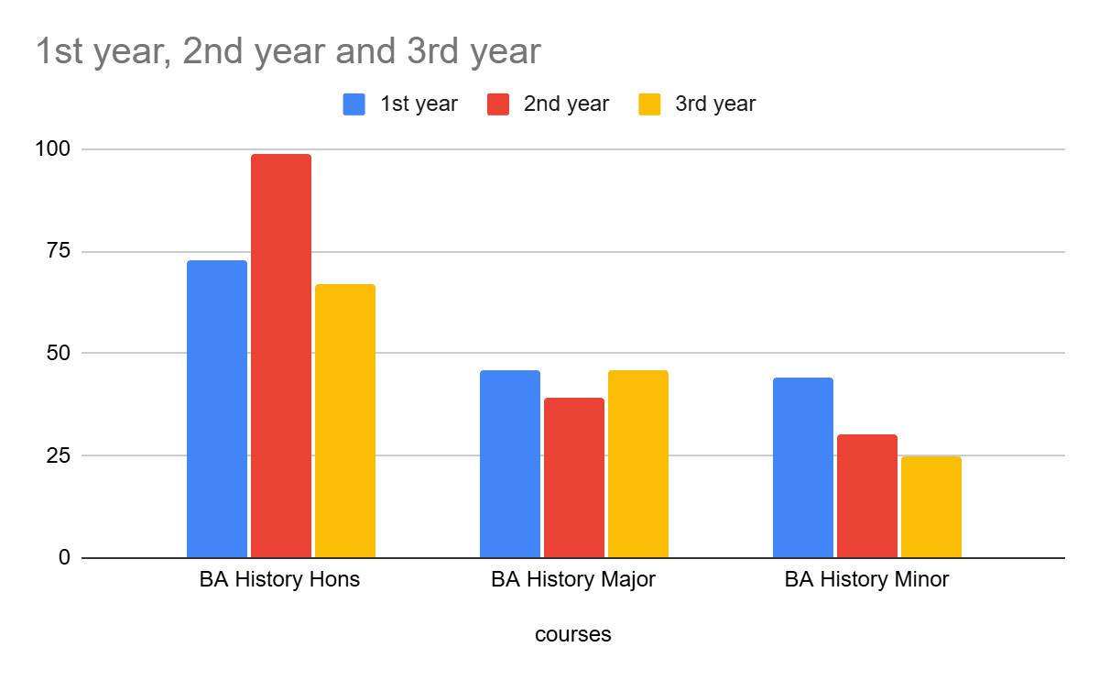
Students in Different Courses (2024-25)

Slide 6
Enrolment- 2021-25
The student enrolment profile for these years is interesting as it shows a move towards an almost equal presence of students from within Delhi and outside in the classroom

Slide 7
Course | Total Student Appeared | Total Student Passed | Students Passed with Above 80% or 8 CGPA | Students Passed with Above 60% or 6 CGPA | Below 60% or 6 CGPA | Total Student Admitted in higher Studies | Percentage of the Students enrolled in higher Studies
B.A. Hons. | 186 | 181 | 02 | 141 | 38 | 18 | 10
B.A. multi-Disciplinary | 143 | 135 | 01 | 121 | 40 | - | -

Slide 8
Students Academic Achievement Data
Name of the Student | Batch | Exam Qualified (UPSC-CSE/PCS/CUET/UGC-NET/IIT-JAM/GATE) | Passing Year | Documentary Proof Link (If Available)
Neha | 2018-2021 | NET | 2021 | NA
Prachi Malik | 2018-2021 | NET | 2021 | NA
Neelu Singh | 2017-2020 | NET | 2024 | NA
Smita Bhattacharya | 2019-2022 | NET | 2024 | NA
Anamika | 2019-2022 | NET | 2022 | NA
Kajal Rajput | 2011-2014 | DSSB | 2014 | NA
Garima Nishtha | 2011-2014 | DSSB | 2014 | NA
Khushboo Kumari | 2011-2014 | SSC | 2014 | NA
Dr. Vanshika Kirar | 2011-2014 | NET | 2014 | NA
Pragati Choubey | 2019-2022 | Air Force | 2022 | NA

Slide 9
The overall student teacher ratio was approximately 1:40 considering Hons. and Prog Courses together.
In addition to classroom teaching, teachers also reach out to students through the College mentorship programme. Currently, most teachers of the department have been assigned 20 mentees each.
The Department follows the Curriculum as decided by the University of Delhi.
Students demand ratio for Hons. is (1:5 during cut off days); 1:3 (CUET) subjective verification.

Slide 10
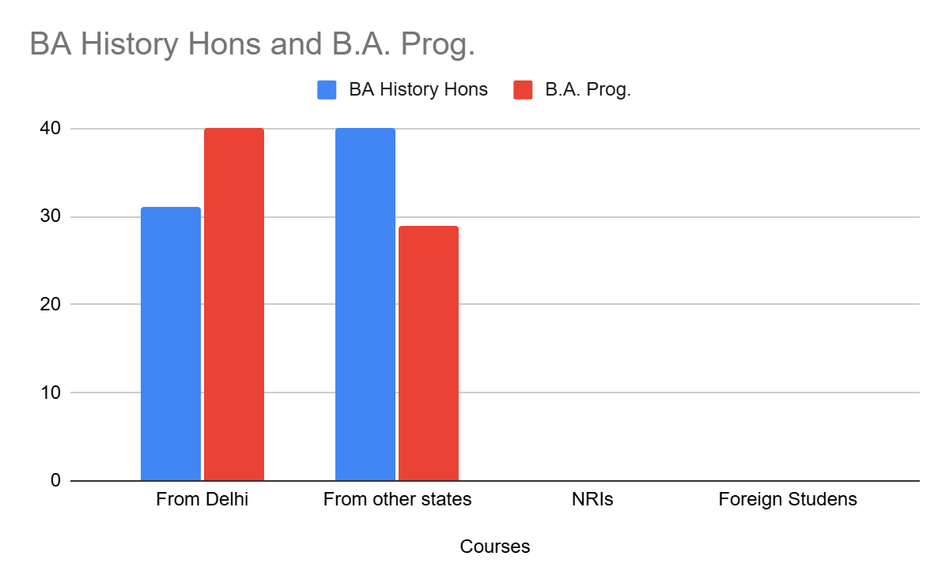
Student Diversity 2024-25

Slide 11
Student Progression in Higher Studies (2023-24)
Program | 1st Year | 2nd Year | 3rd Year
DSC | History of India-I Social formation and Cultural patterns-I History of USA -I History of India-II Social formation and Cultural patterns-II History of USA -II | History of India-III Rise of Modern west-I History of India-IV History of China 1840-1950 History of Modern Japan 1868-1950 Rise of Modern west-II | History of India 1750-1857 History of Modern Europe -I History of India 1500-1600 History of India 1600-1700 History of India 1857-1950 History of Modern Europe -II
DSE |  |  | Travel in History: Trade, Politics and Society Gender in Indian History upto 1500, Gender in Indian History 1500-1950
GE | Delhi Through the Ages I &II Understanding Indian Heritage | Religious Tradition in Indian Sub- Continent Educational Arrangements and Knowledge in Modern India Media in History | Gender in Modern World Media and Cinema Women in the Indian History
SEC | E- Tourism (112)* Museum and Museology (52)* Reading The Archives (48)* | E- Tourism (61)* Museum and Museology (54)* Reading The Archives (48)* | E- Tourism (64)* Museum and Museology (65)* Reading The Archives (51)*
VAC | Ethics and Value in Ancient Indian Tradition (60)* | Ethics and Culture (47)* Sahitya, Cinema aur Sanskriti (57)* Culture and Communication (72)*
Notes:
* No. of Students.
Note: History department offers SEC papers to 600 students i.e. 20% of the college strength (approximately 3000 students are currently enrolled in college).

Slide 12
FACULTY STRENGTH AND SPECIALIZATION
S.no | Name | Designation and Date of Joining | Experience(in years) | Qualifications | Specialization | No. of M.Phil/Phd supervised
1. | Dr. Shakti Madhok | Associate Professor, 09/05/2006 | 30 | Ph.D. | Ancient Indian History and Area Study Of China in particular and East Asia in general | 2 (Ph.D.)
2. | Dr. Fatima Hussain | Assistant Professor, 17/02/2006 | 27 | Ph.D. | Medieval Indian History
3. | Dr. Dinesh Singh | Assistant Professor, 03/03/2017 | 9 | Ph.D. | Buddhist History
4. | Dr. Nagendra Kumar | Assistant Professor, 02/03/2017 | 13 | Ph.D. | Medieval Indian History
5. | Dr. Madhuri Sharma | Assistant Professor, 02/03/2017 | 18 | Ph.D. | Modern Indian History | 2 (Current Ph.D.)
6. | Dr. Jaspal Singh | Assistant Professor, 09/03/2017 | 16 | Ph.D. | Modern Indian History
7. | Mr. Levin NR | Assistant Professor, 06/03/2017 | 15 | Pursuing Ph.D | Modern Indian History
8. | Ms. Shobhana Sinha | Assistant Professor, 02/03/2017 | 19 | Ph.D. | Medieval Indian History
9. | Dr. Mithilesh Mishra | Assistant Professor, 07/12/2023 | 8 | Ph.D. | Modern Indian History
10. | Dr. Chhaya | Assistant Professor, 07/12/2023 | 17 | Ph.D. | Ancient Indian History
11. | Dr. Puna Ram | Assistant Professor, 01/01/2024 | 1 | Ph.D. | Ancient Indian History
12. | Dr. Madhwi | Assistant Professor, 07/12/2023 | 10 | Ph.D. | Modern Indian History | 2 (Current Ph.D.)
13. | Dr. Ramesh Ram Patel | Assistant Professor, 08/12/2023 | 1 | M.Phil. | Modern Indian History
14. | Vacant
15. | Vacant

Slide 13
S.N. | Name | No. Paper Published in 2023-24 | No. of Books Published
1. | Dr. Shakti Madhok
2. | Dr. Fatima Hussain
3. | Dr. Dinesh Singh
4. | Dr. Nagendra Kumar
5. | Dr. Madhuri Sharma | 01 | 01
6. | Dr. Jaspal Singh | 01 | 01
7. | Mr. Levin NR | 01
8. | Ms. Shobhana Sinha
9. | Dr. Mithilesh Mishra
10. | Dr. Chhaya
11. | Dr. Puna Ram |  | 01
12. | Dr. Madhwi | 02 | 01
13. | Dr. Ramesh Ram Patel

Slide 14
FACULTY PROFILE
.
The History Faculty of Bharati College is a qualified, committed and enthusiastic group comprising 13 members.
Most members have produced new knowledge in their fields and contributed to original scholarship.
Eleven books on significant topics have been authored by teachers of the department at different times, including by Dr. Shakti Madhok, Dr. Fatima Hussain, Dr. Madhuri Sharma, Dr. Jaspal Singh, Dr. Chaya and Dr. Punaram. Dr. Madhwi has designed an online module on European history for the Swayam Prabha channel of IIT Kanpur.
Most members have published in UGC Care or Peer Reviewed journals. In the two years under review- Dr. Madhuri’s, Dr. Puna Ram’s and Dr. Mithilesh’s research have featured in important publications.
The following slides contain a general list of publications across the years of the Department faculty which reflect the diverse interests and academic specializations of members of the Deptt.

Slide 15
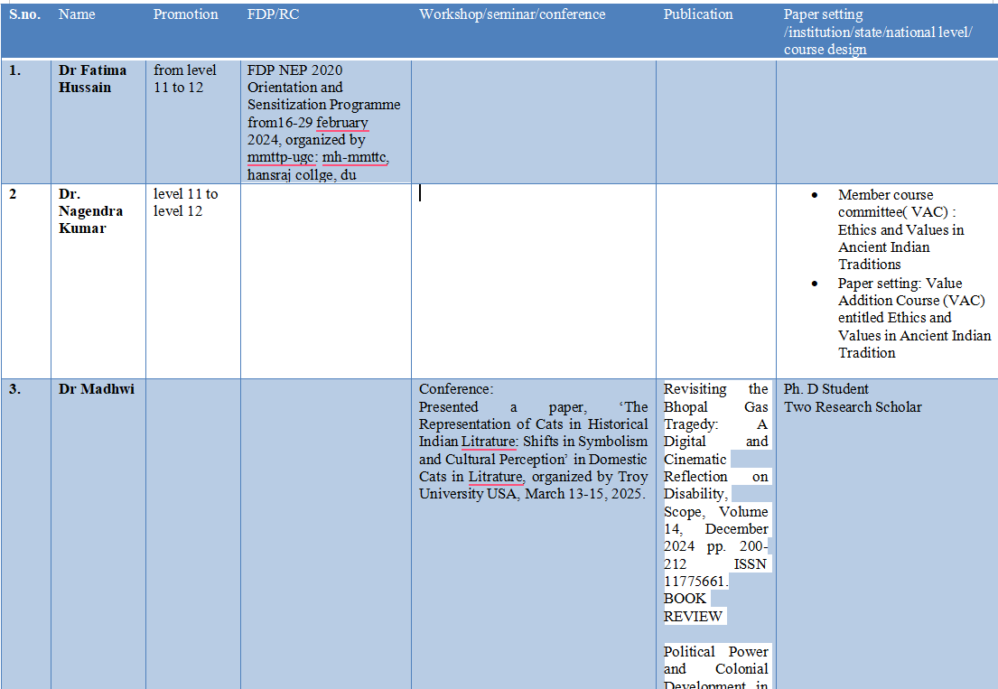
Recent academic accomplishments-

Slide 16
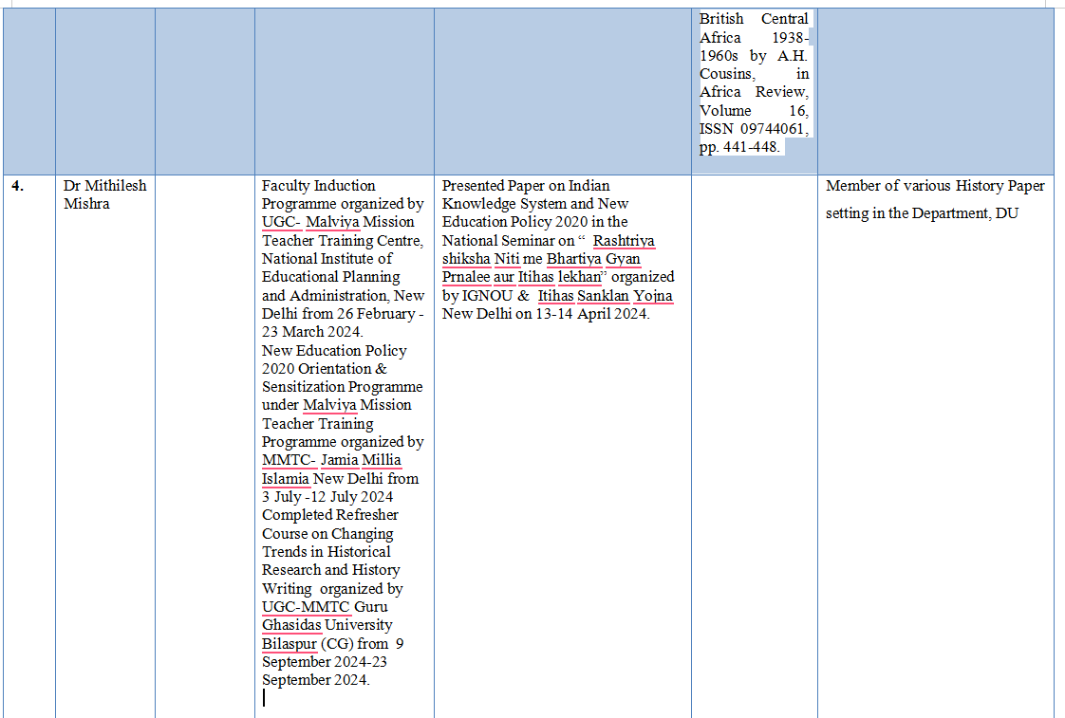

Slide 17
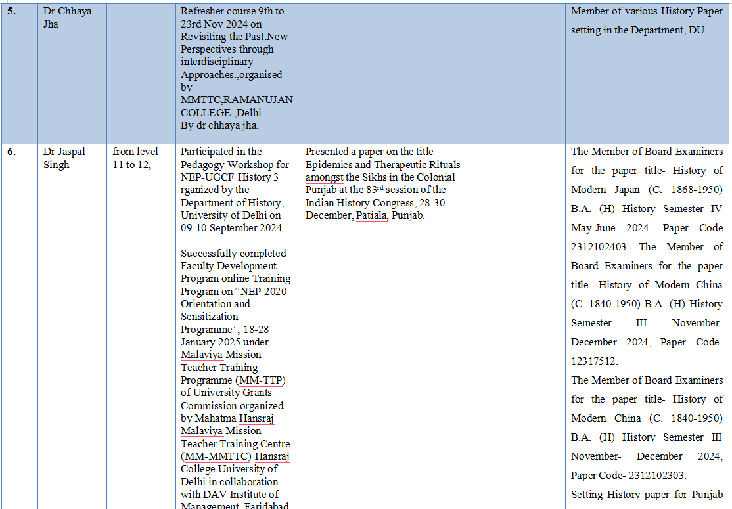

Slide 18
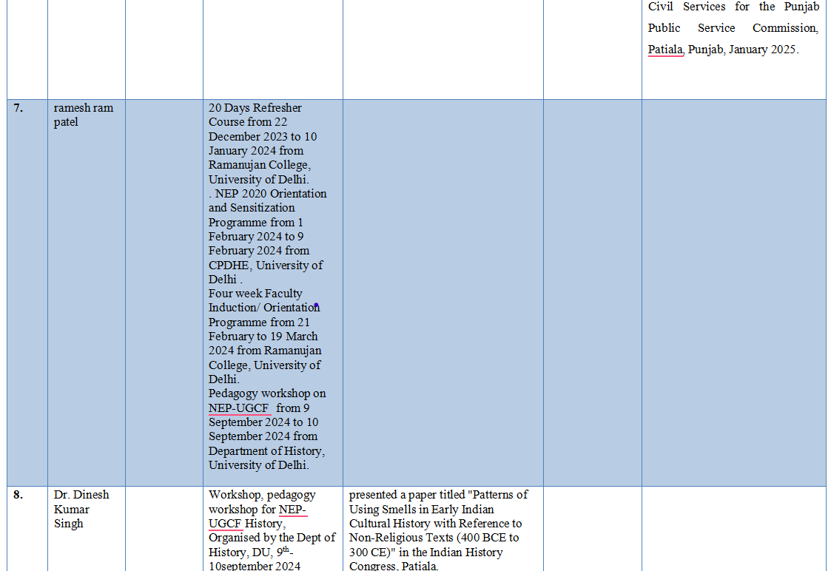

Slide 19
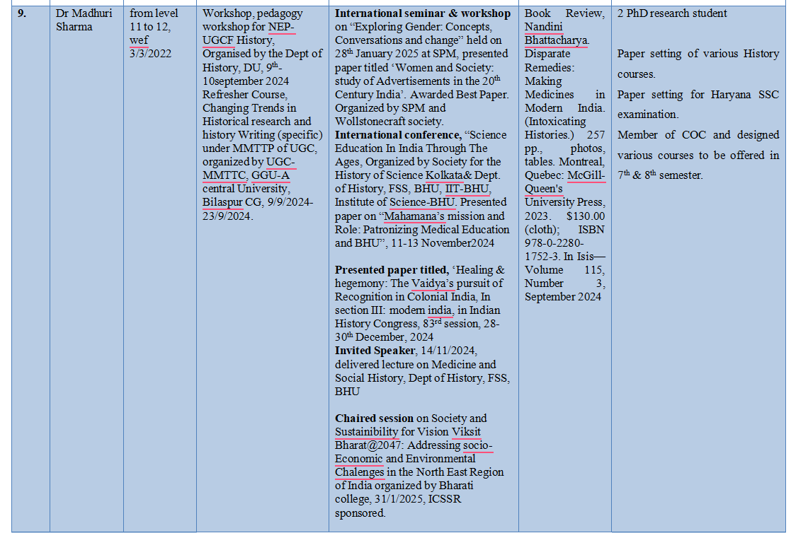

Slide 20
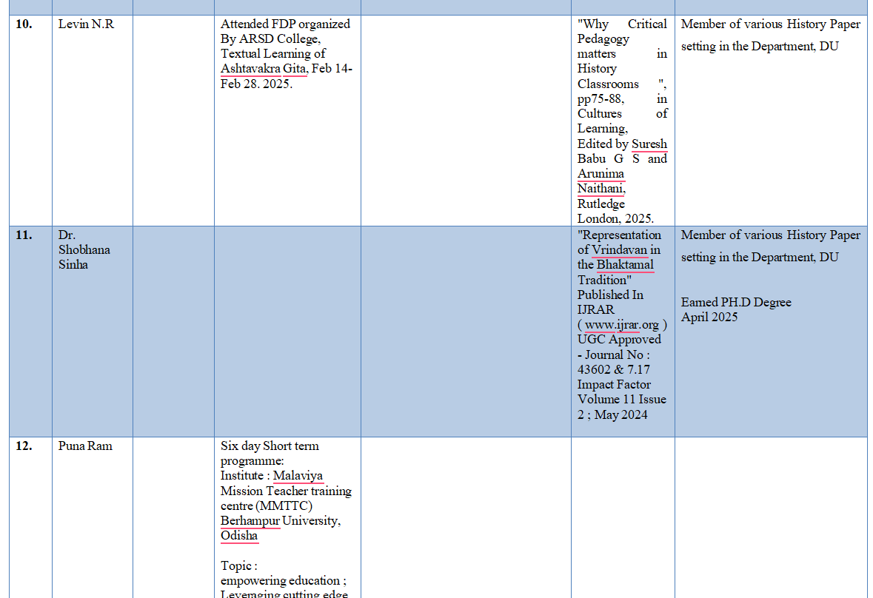

Slide 21
PREVIOUS PUBLICATIONS

Slide 22
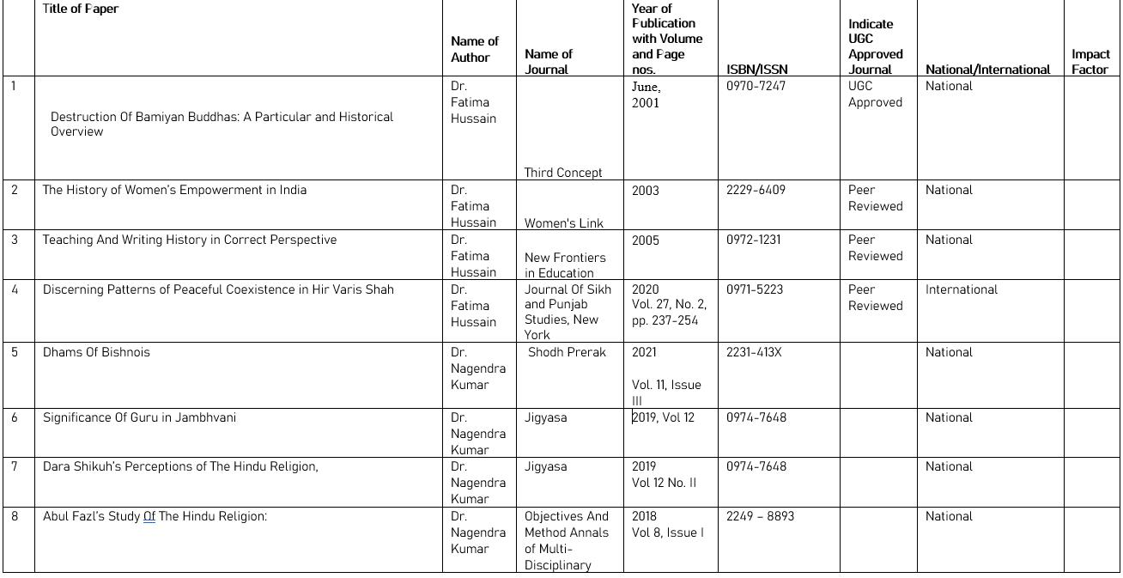

Slide 23
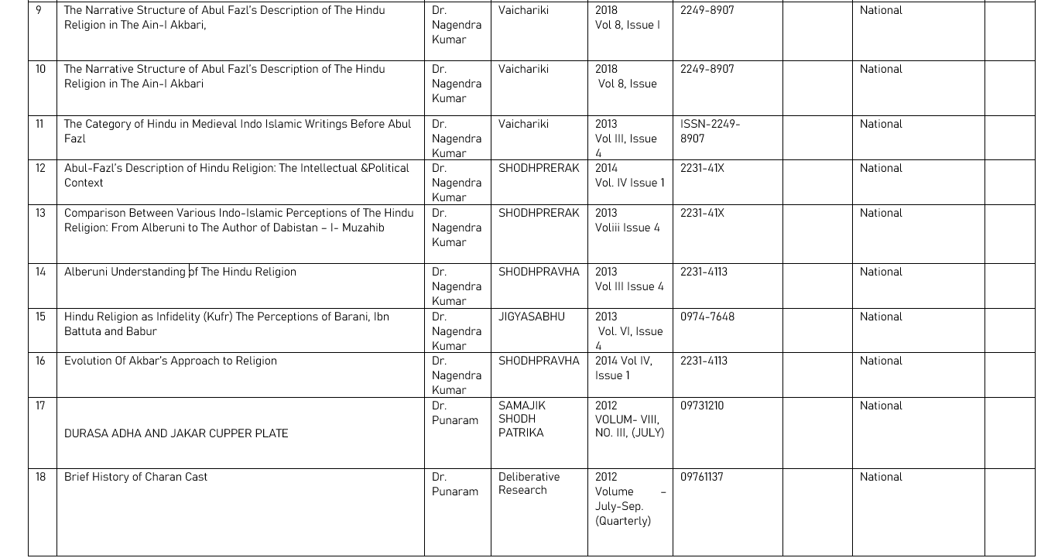

Slide 24
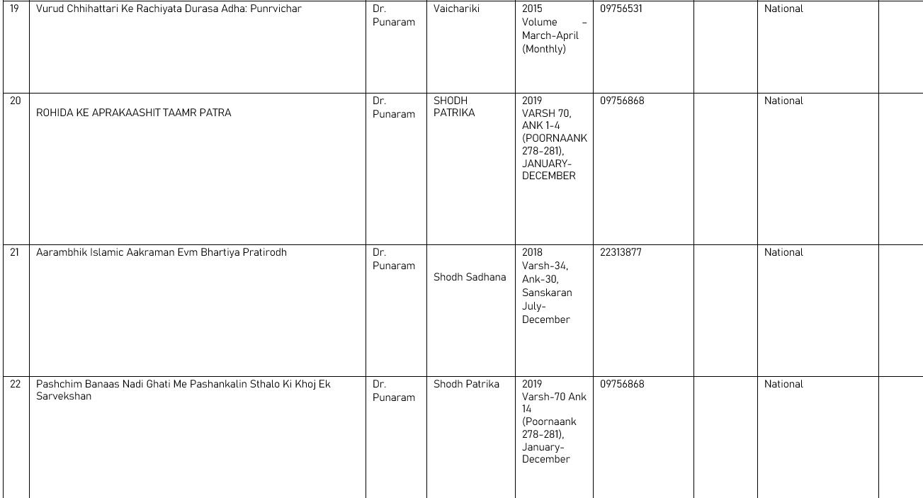

Slide 25
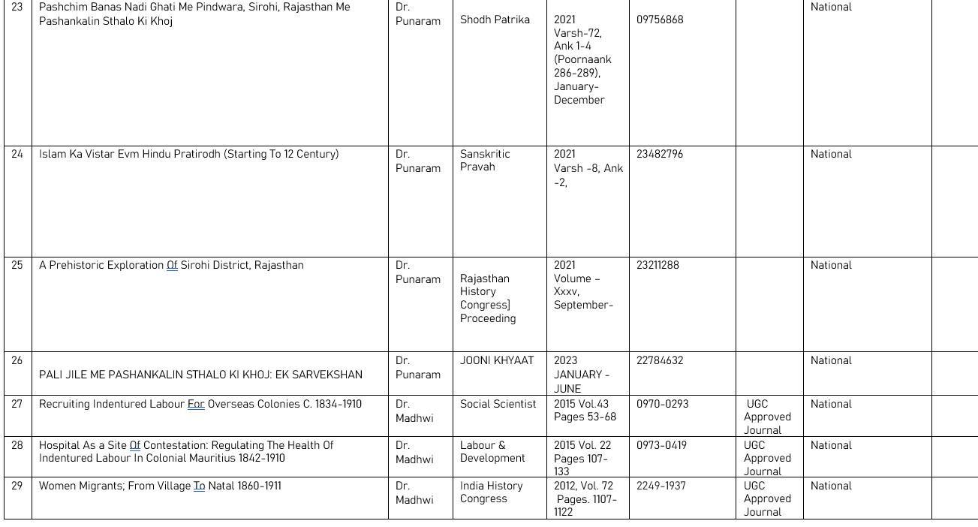

Slide 26
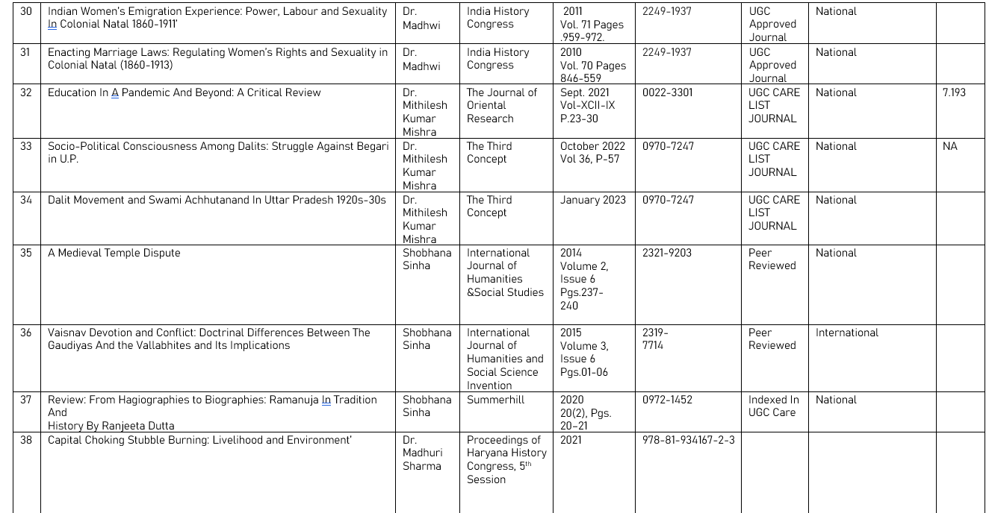

Slide 27
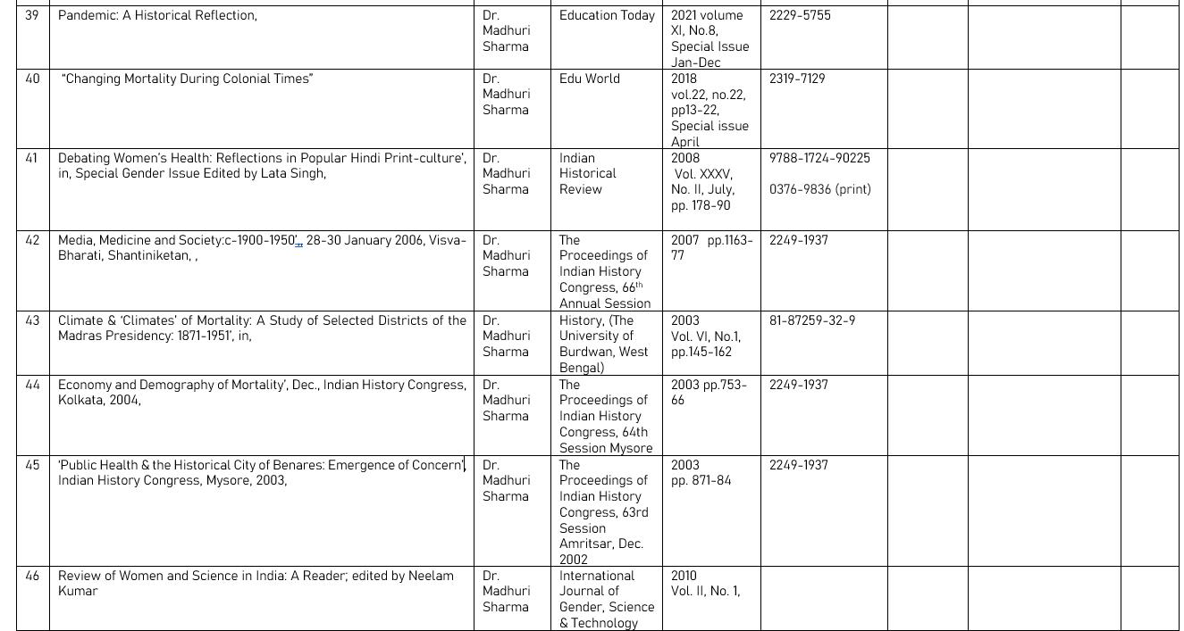

Slide 28
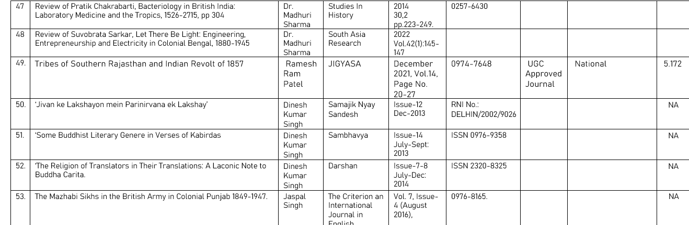

Slide 29

PRAVAH
Pravah is the Departmental Society- a space for students to learn in real time as well as connect to the larger campus community.
The learning starts at the outset, when candidates are chosen through elections to fill office- for many, their fist experience of the democratic enterprise. Apart from these scholarly initiatives, educational excursions were also conducted.

Slide 30

PRAVAH
 | ACADEMIC ENGAGEMENTS 2024-25
1. | NAME OF CONVENER | TITLE OF TALK | SPEAKER | DATE | No of Participants
1. | Dr. Dinesh Singh | Mahatma Gandhi; Intellectual Foundation and Political Action | Dr. Bhuwan Jha Department of History, University of Delhi, . | 24/04/2021 | 100+
2. | Dr. Dinesh Singh | Discourse of Pleasure and Leisure in Mathura Art, | Professor Seema Bawa, Department of History, University of Delhi, | 24/02/2025 | 150+

Slide 31
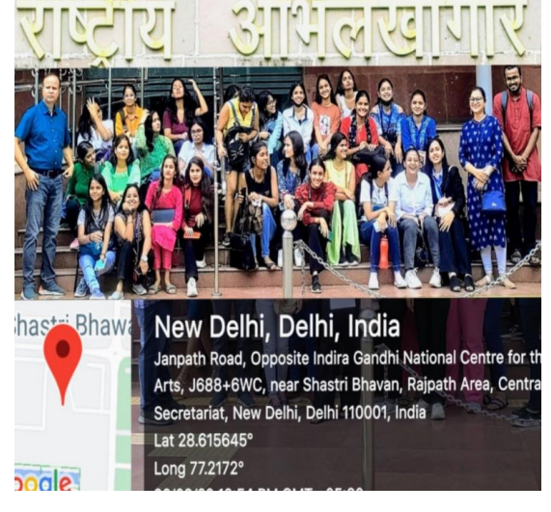
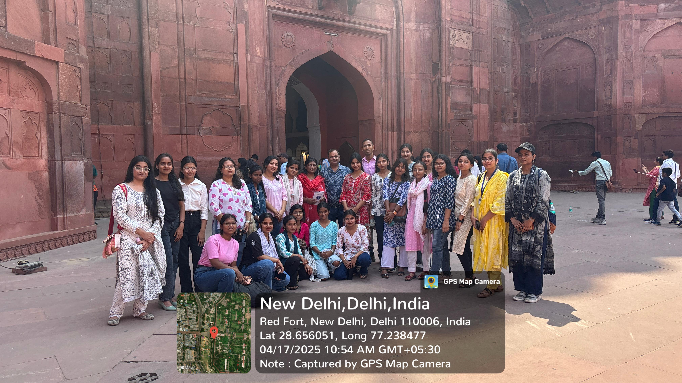
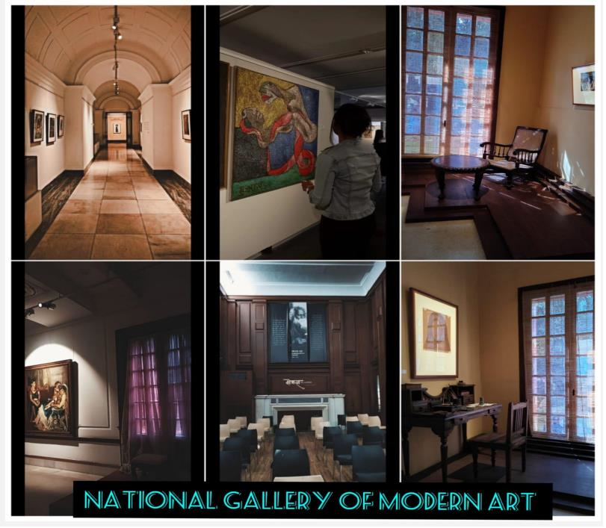
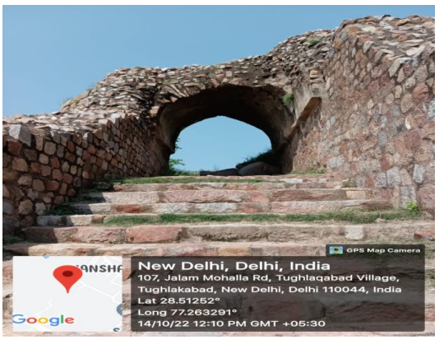
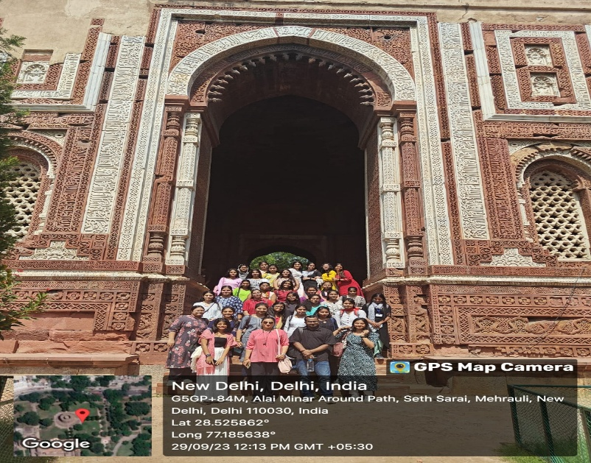
A total of 7 educational visits- to the National Museum, the National Archive. Shahjahanabad and the Delhi Townhall, among others with different batches was organised by Pravah
An archaeological field visit was organised to Rakhigarhi. An outstation educational trip to Old Manali was also organised.

Slide 32
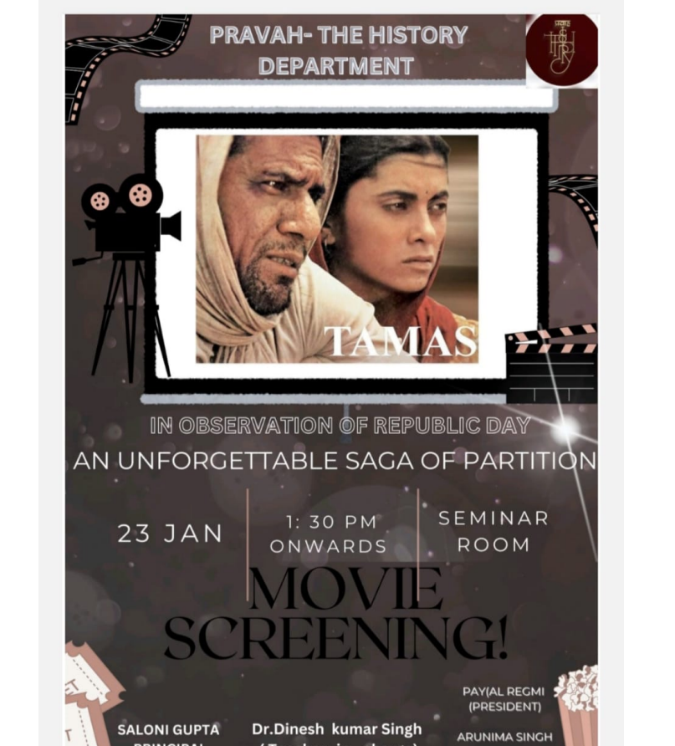
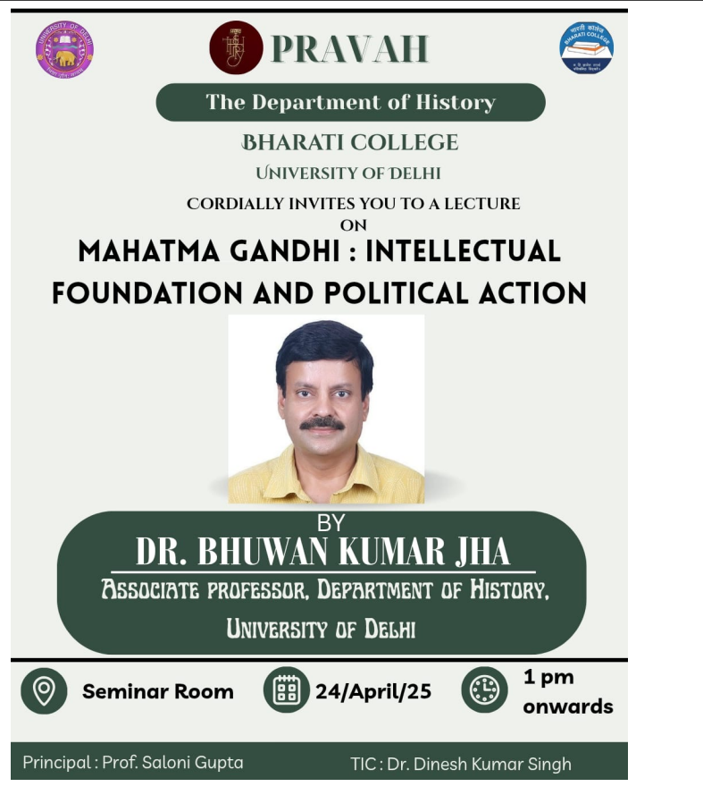
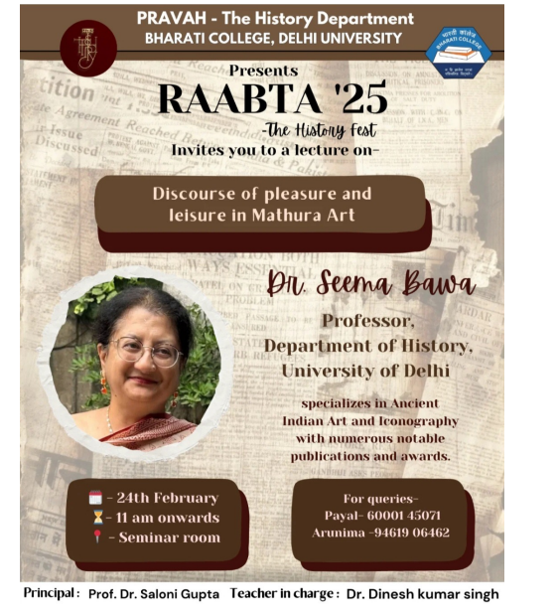

Slide 33
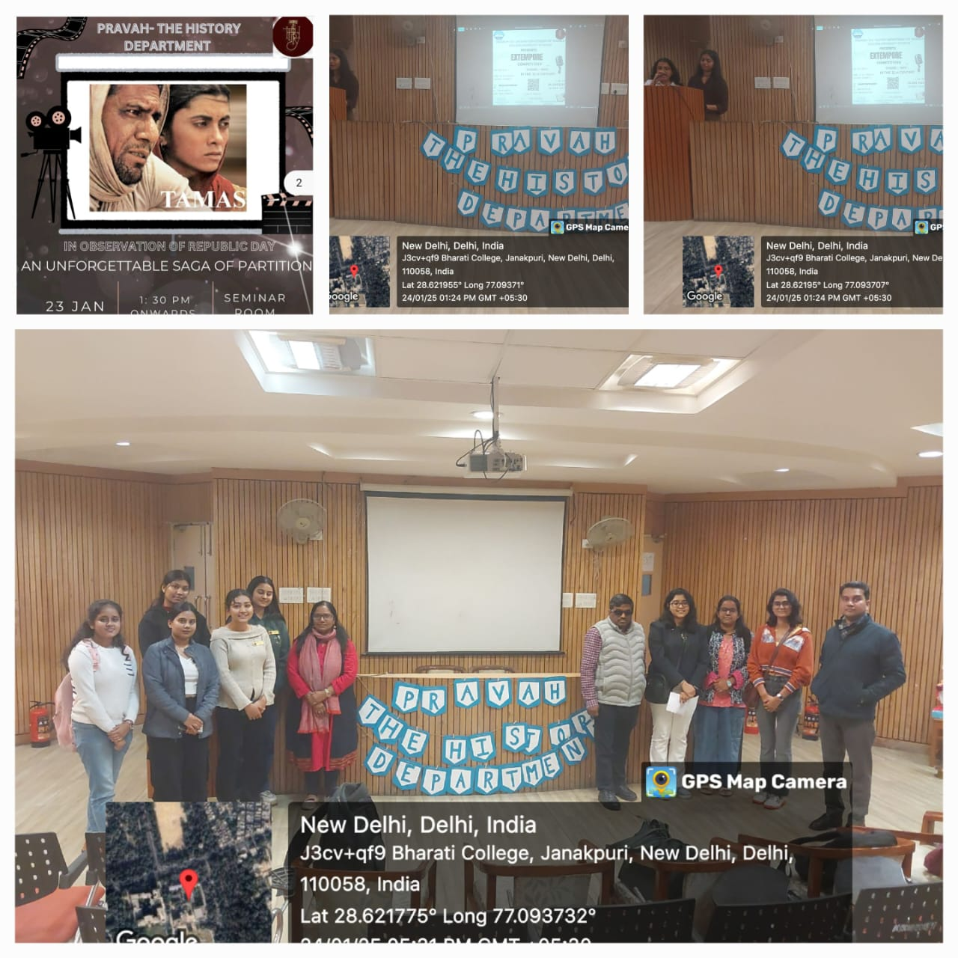

Slide 34
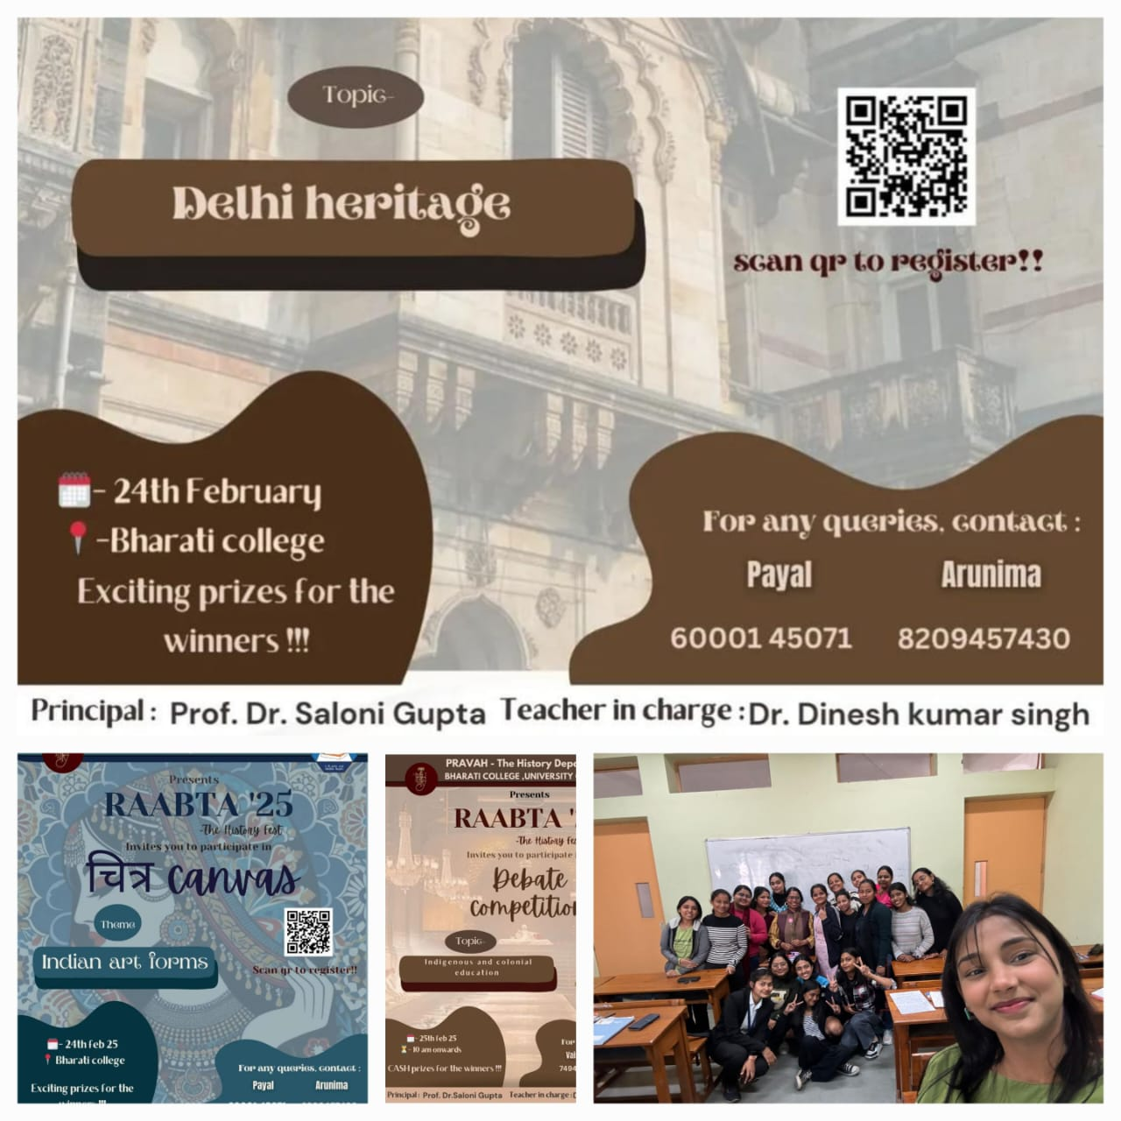

Slide 35
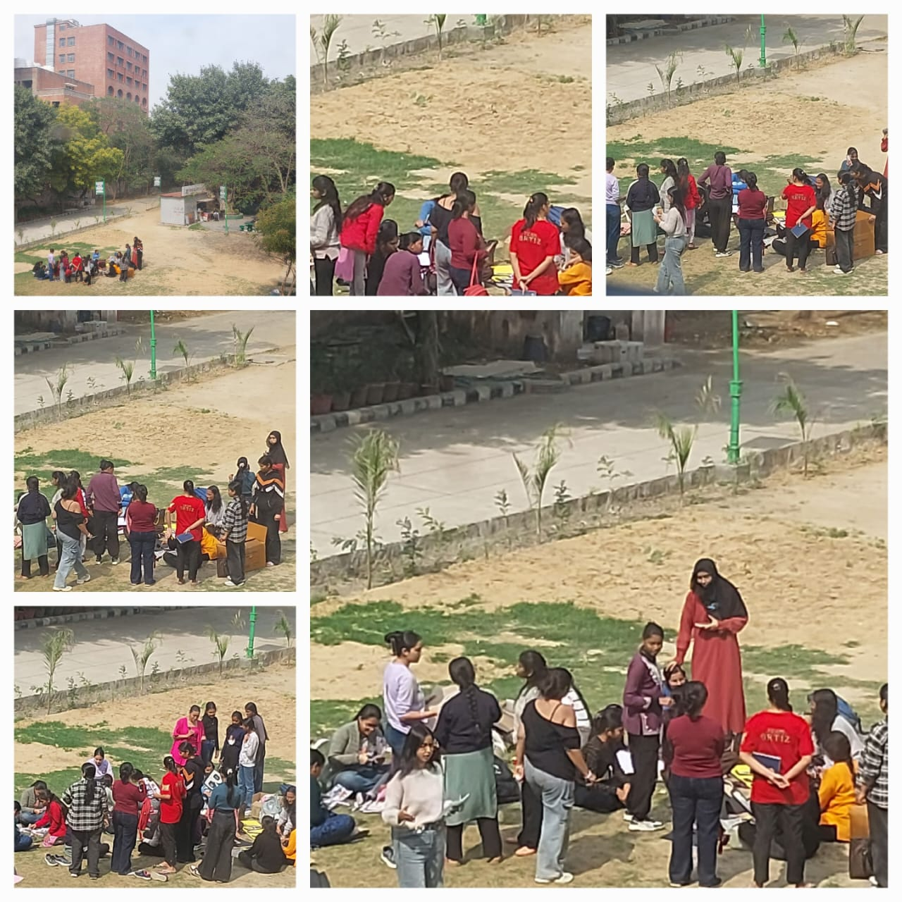
History in the Field: Innovative Teaching Practices:

Slide 36
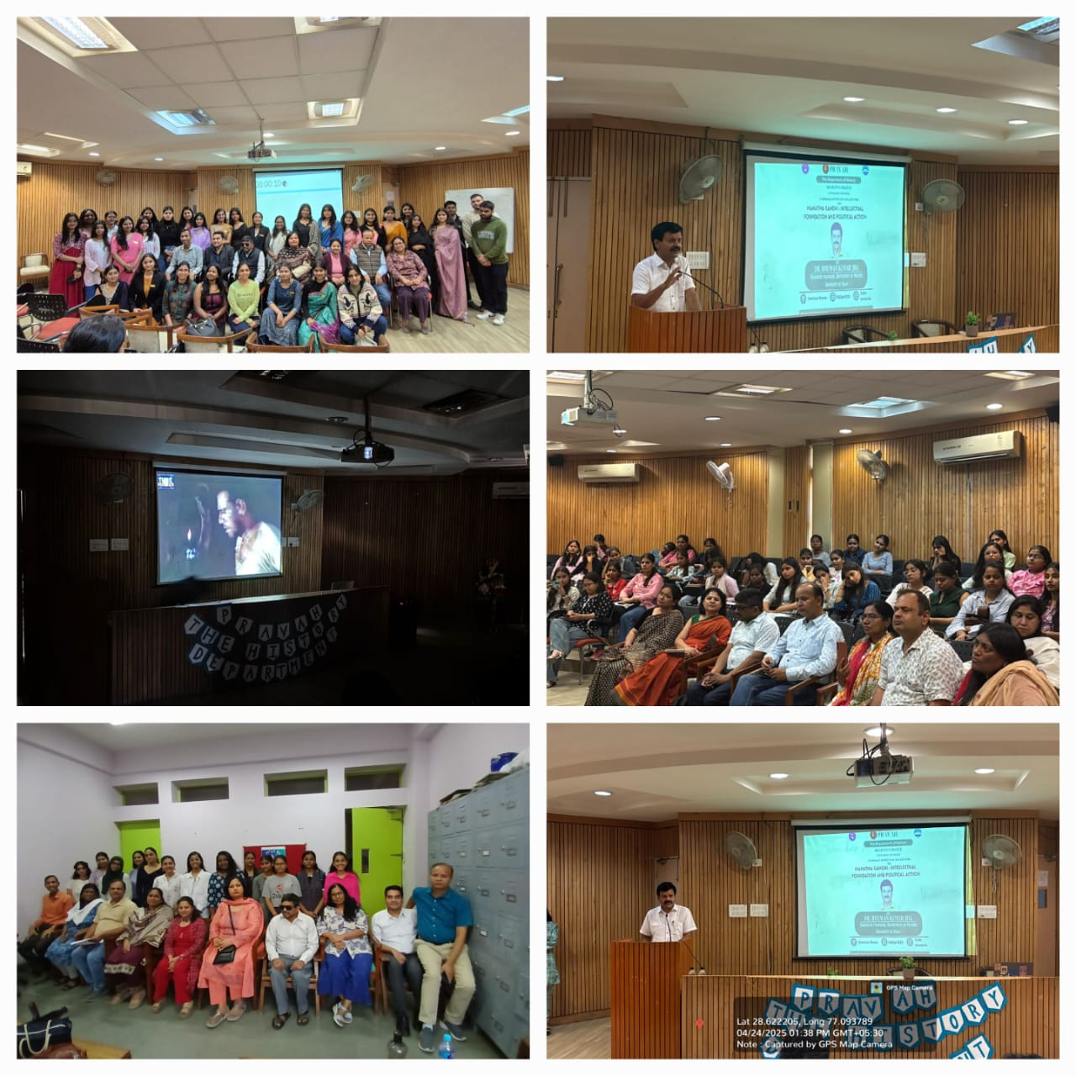

Slide 37
Alumnae
Our Alumnae are doing well in their respective fields. We have made continous and systematic efforts to reach out to our Alumnae. An Alumnae Lecture series has been finalised.
In our knowledge, 4 of our students in the reporting period have cleared UGC-NET. One student is doing Ph.D from Jamia, and another has earned her doctorate and is currently guest faculty in DU
Many students have transitioned to higher studies- mostly M.A in History, but also Law, Education and B.Ed.
Some of the Alumnae of the Department are doing exceedingly well- as reflected in the next slide.

Slide 38
OUR NOTABLE ALUMNAE
NAME OF STUDENT | Email | Designation | Present Employer | Employer Address | Pay Package
Sanchita Aggarwal | agarwal.sanchita12@gmail.com | Assistant Conservator | Indian National trust for Art and Cultural Heritage (INTACH) | INTACH 71, Lodi Estate, New Delhi | NA
Soumya Verma | NA | Ph.D. Researcher Internship at Lok Sabha | Jamia Milia Islamia | Jamia Milia Islamia
Snighdha Patra | snigdha.patra@gmail.com | Chef De Partie | The Hilton | The Hilton, Auckland New Zealand | NA
Vanshika Kirar | vanshika23@gmail.com | Guest Faculty | Shivaji College (DU) | Shivaji College (DU | NA
Kajal Rajput | luvufriends24@gmail.com | PRT | Adarsh Public School | Adarsh Public School, Vikas Puri | NA
Rimli Das | Riimlidas2000@gmail.com | Founder | ARJB Farms | ARJB Farms, Guwahati | NA

Slide 39
CONTD.
Heba Abbas | heba.abbas96@gmail.com | Associate Researcher | Blue Kraft Digital | Lower Parel, Mumbai 400013 India | NA
Keerti Sombhavi | keertisombhavi@gmail.com | Relationship Manager | Mo School Abhiyan Parichalana Sangathan, Govt of Odisha | School and Mass Education Department, Govt of Odisha | NA
Ayushi Srivastav | srivastavaayushi2312@gmail.com | Academics Operations Manager | PW (Physicswallah) | PW (Physicswallah), Gurugram | NA
Arunima Tiwari | aruart20@gmail.com | Research Assistant | Indian Institute of Heritage (Formerly National Museum Institute) | National Museum Institute of History of Art, Conservation & Museology A-19, Institutional Area, Sector - 62, NOIDA | NA

Slide 40
Innovative Teaching Pedagogy /Best Practices of the Department
Department has adopted following teaching pedagogies:
Organising field trips to provide experiential learning to the students.
Visit to Archaeological sites
Inviting experts from various academic fields
Screening of relevant movies and documentaries
The faculty use innovative advanced technologies to felicitate diverse information

Slide 41
Strengths of the Department of History:
The Department of History is distinguished by its highly qualified faculty, the majority of whom hold Ph.D. degree. The faculty members are well-prepared and enthusiastic to mentor research students across a wide range of areas. These include social, political, economic, spiritual, religious, and archaeological studies, as well as the historical development of various branches of science.
The department has observed that its students demonstrate the ability to adopt constructive and research-oriented approaches, indicating strong potential for academic growth and contribution to the field.
Another strength of the Department is that it offer bilingual teaching to cater diverse student population which is communicate with the students with easy going way.

Slide 42
Weakness:
Absence of a separate Department Room and Library.
The Department currently faces a lack of modern technological tools necessary to connect students with structured, systematic and comprehensive knowledge.

Slide 43
Opportunities
Given the expertise and the specialisations of the faculty, the Department is considering launching a Heritage Walk series- which can be a way of connecting and giving back to the local community. It could be further developed as form of Consultancy.
Feedback from our students has indicated to us that a Departmental initiative for training civil services aspirants- especially for the History optional can be very successful. Many of the faculty serve as experts in Dhairya- the civil services society of the College.

Slide 44
Challenges
Arranging sponsorships and other funding for the different programmes is a regular challenge
Creating Sustainable Alumnae Networks

Slide 45
RoadMap/Future plan
History is not merely the study of the past. It is also the analytical exploration of transformations across time. It aids us in discerning which elements have remained constant and which have undergone significant change. Furthermore, it meticulously traces the evolution of ideas and material realities across different historical epochs, offering a structured account of shifting conceptual frameworks.
Artificial Intelligence is produced through serious scientific operation of the past. Therefore, it is required to systemise data of every thing and being. In this light, it becomes imperative for the Department of History to adopt Universal Design for Learning, so as to create classrooms that are responsive to the needs of multilingual, multilevel, and multicultural students. This inclusive approach will enable learners from diverse backgrounds to engage more meaningfully with historical studies.
In recent years, the discipline of history has made remarkable strides by integrating with various interdisciplinary fields such as:
Genetics Study
Computer Science
Data Study
Social Art
Social Psychology
In recognition of these dynamic developments, there arises a compelling need for the establishment of a laboratory space within the department—a dedicated environment where both educators and students may pursue self-development and scholarly research, thereby elevating the institution to greater heights of academic excellence.
Creation of a Historical Resource Centre to provide the Primary Sources and hands on experience for practical training .
Work towards expanding the Department, where new specializations can be accommodated
Work towards raising the intake capacity
Comprehensive Training and workshops for faculty as well as students to equip them with the tools of Artificials Intelligence

Slide 46
Any other Information
Members of the History faculty regularly lend their expertise to different national and international institutions. Dr. Jaspal Singh has served as a subject expert for the Rajasthan Public Service Commission. Dr. Madhuri Sharma and Dr. Shobhana Sinha have served as experts for the NTA(National Testing Agency). Dr. Nagendra Kumar has provided his expertise for the Samiksha Election Survey series of CGS,DU.
The faculty also works closely with the University in several academic endeavours- such as Syllabi revision and Course development.

Slide 47
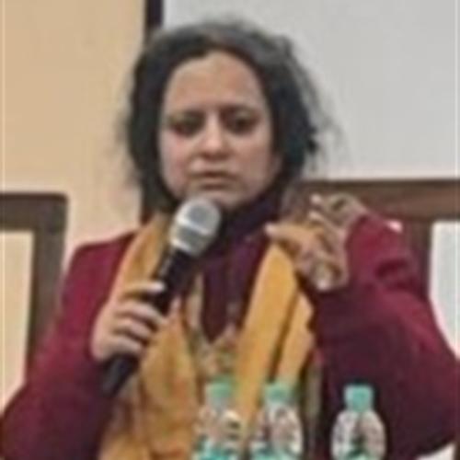
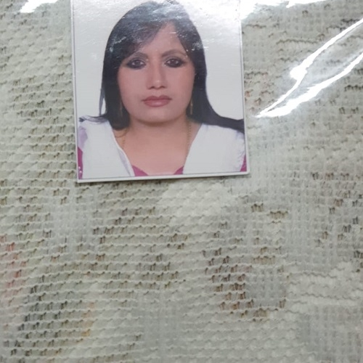
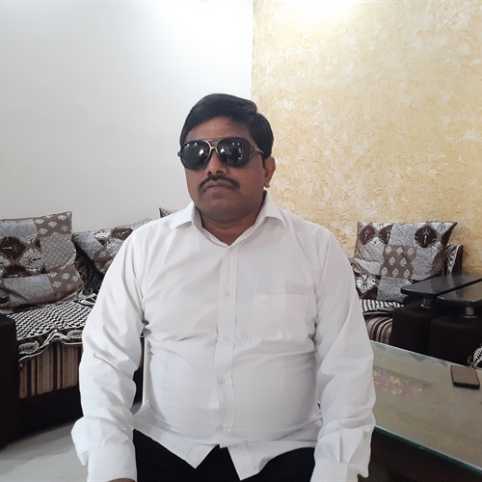
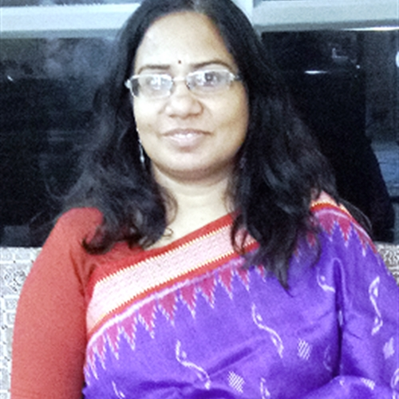
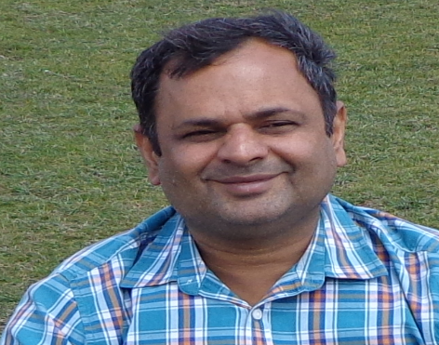
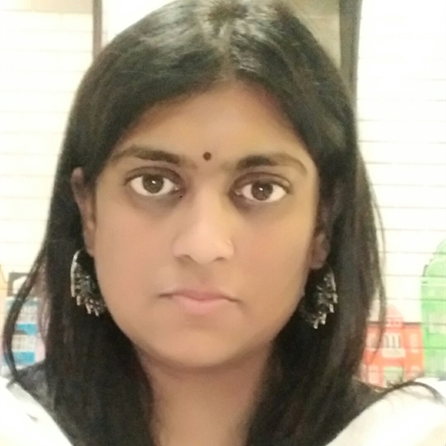
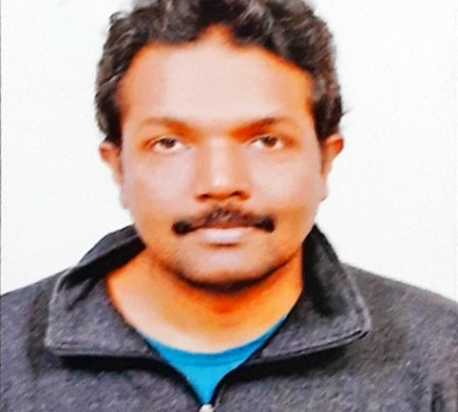
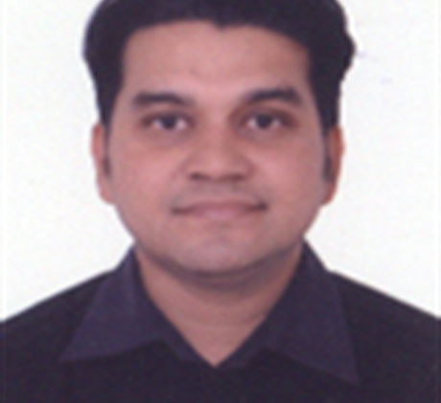
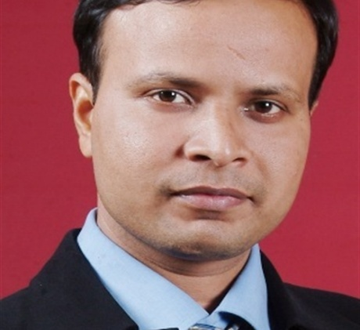
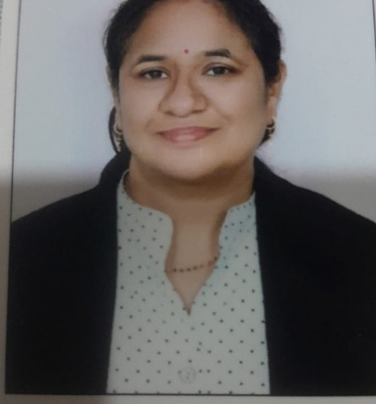
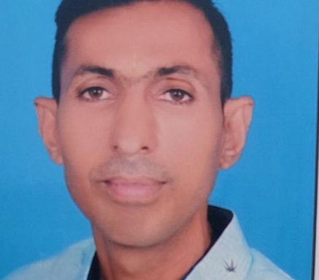
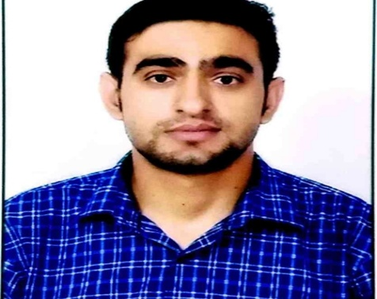
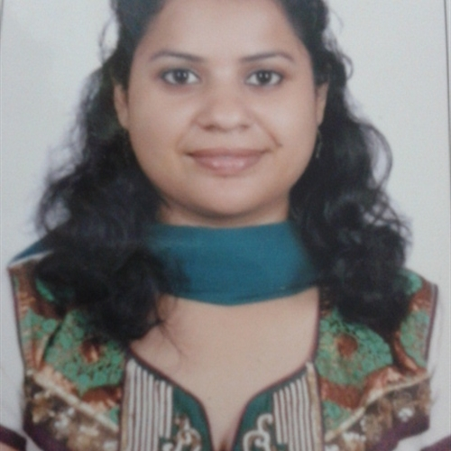
The Faculty
L to R- Dr. Shakti Madhok, Dr. Fatima Hussain, Dr. Dinesh Singh, Dr. Madhuri Sharma, Dr Nagendra Kumar
2nd Row L to R, Ms. Shobhana Sinha, Mr. Levin NR, Dr. Jaspal Singh, Dr. Mithilesh Mishra, Dr. Chaya, Dr. Puna Ram
3rd Row Mr. Ramesh Patel, Dr. Madhwi

Slide 48
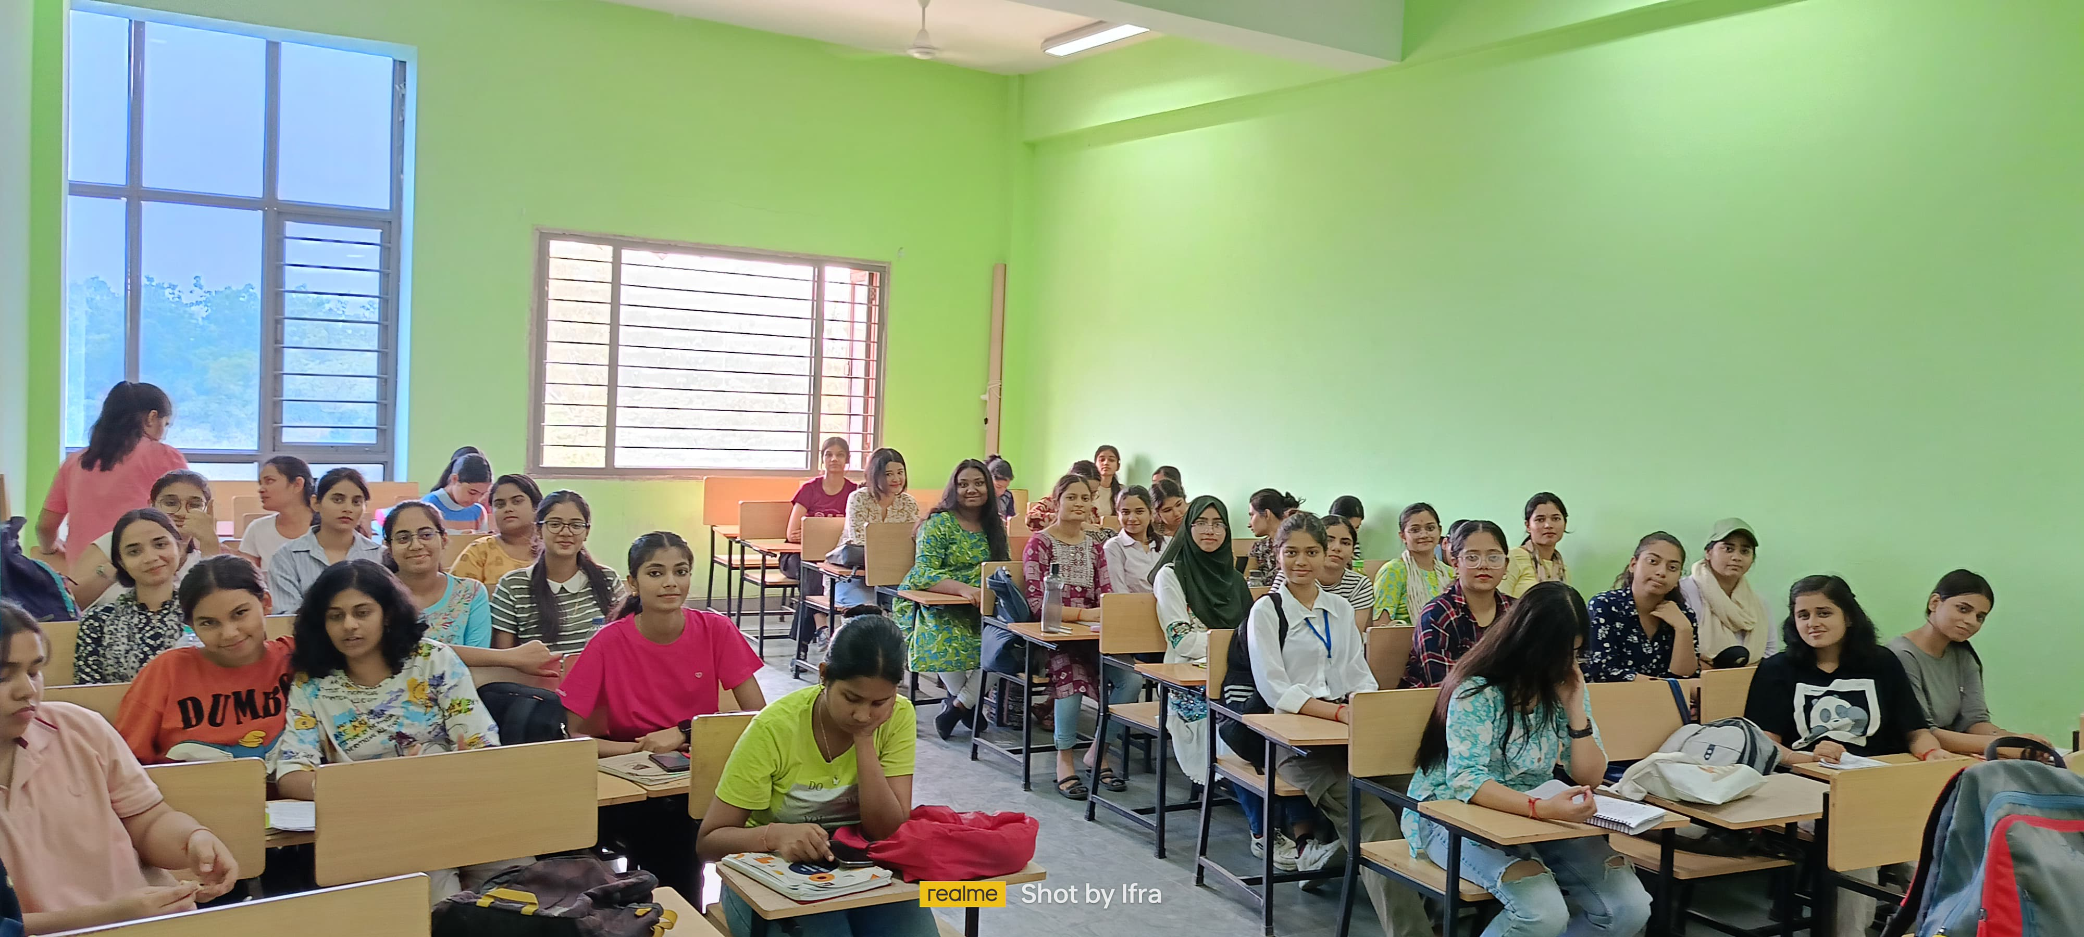
THE HISTORY CLASSROOM

Slide 49
